Slide 1

Event Sourcing w/ DDD

Slide 2
Recap
Notes:
Took the concept of pushing business logic down into the domain, rather than having what’s called an anemic domain model, we have a model rich in behavior. This allows for more explicit modeling of our domain, better unit testing, and better encapsulation of our business rules. Towards the end I made a quick note about Event Sourcing and how modeling our domain this way sets us up to do Event Sourcing. I know we’ve had a few conversations about it and I wanted to follow up on it and do a POC to see how practical it could be and see what you guys think.
Before we can start talking about Event Sourcing, we need to take another tool from DDD and that is the concept of Domain Events

Slide 3
Domain Events Bringing EDA to the Solution Level
Notes:
Domain Events come from DDD
It’s how we bring EDA down to the solution level
They are what make Event Sourcing “Practical”
You can do Event Sourcing w/o DDD, but it’s a lot more “messy” and less explicit

Slide 4
What is a Domain Event?
Immutable representation of something that has happened in the past that can be used to trigger additional behavior (side-effects) within the same domain that the event was raised in.

Slide 5
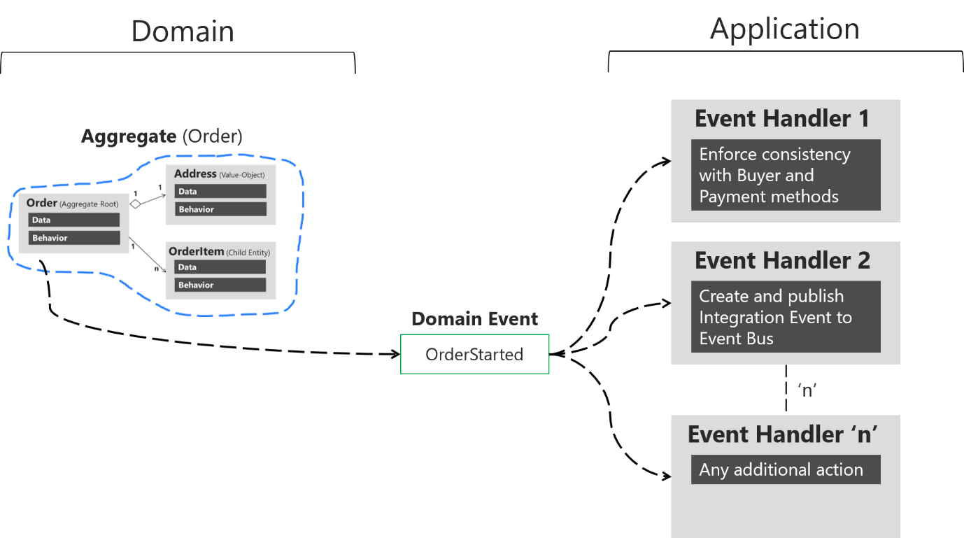
Domain events: Design and implementation - .NET | Microsoft Learn
Notes:
User sends a request or command to “start” an order
That Order then creates and raises an “OrderStarted” event WITHIN the domain, typically using something like MediatR
Any number handlers, responsible for a single “side-effect”

Slide 6
Event Driven Architecture
Solution A
Solution B
Solution C
Service Bus

Slide 7

Event Driven Architecture
Solution A
Event Handler
Solution A
Domain Model
Solution B
Solution C
Event Handler
Event Handler
Service Bus

Slide 8
Why Domain Events?
Decouple “Side-Effects” from the Original Command (SRP)
Additional behaviors/side-effects are more explicitly modeled
Extensibility – New features can be introduced w/o modifying existing code (Open/Closed Principle)
Sets us up beautifully for Event Sourcing
Notes:
As additional business rules and side-effects grow, are code becomes tightly glued together and a single class becomes responsible for handling all these additional behaviors, violating SRP
2. Clearly understand the “consequences” of a command or request

Slide 9
Why Domain Events?
Decouple “Side-Effects” from the Original Command (SRP)
Additional Behaviors/Side-Effects are Explicitly Modeled
Extensibility (Open/Closed Principle)
Sets up for Event Sourcing
Notes:
As additional business rules and side-effects grow, are code becomes tightly glued together and a single class becomes responsible for handling all these additional behaviors, violating SRP
2. Clearly understand the “consequences” of a command or request

Slide 10

Event Sourcing

Slide 11
Saving State
Orders
{ “id”: 123, “customerId”: 456, “status”: “Ordered” “lineItems”: [ { “…” } ] }
Add Item Request
Order
Apply Business Rules/Raise Domain Event

Slide 12
Event Streams
Replay Events for Current State
Add Item Request
Item Added
Item Removed
Order
Apply Business Rules/Raise Domain Event
Status Change
Item Added
Event Stream
Notes:
This is good for commands that are modifying a single aggregate instance, but not so good for queries who need to join several aggregates together

Slide 13




Reading Data
Read Models/Materialized Views
Orders Event Stream
Customers Event Stream
Products Event Stream
Notes:
Create specific read model/materialized view for our use case

Slide 14
Why Event Sourcing?
No Data Loss
“Visibility” Requirement
Extensibility
Debugging
Optimize Reads/Writes
Notes:
1. Complete historical data, reporting
2. Tells us where it’s been, where it’s at, and how it got there – purpose behind current state
3. Open/Closed Principle by adding new events/read models
4. Event stream gives us what changes have been made
5. More of a CQRS thing, but you can’t achieve the full power and benefits of Event Sourcing w/o CQRS

Slide 15

Implementation

Slide 16




Write Side
Domain
Model
Domain
Model
Event Handler
Service Bus
Event Handler
Event Store
Command
Application Service (Command Handler)
Event Handler
Read Model
Create/Update
Projection

Slide 17
Read Side
Query
Application Service (Query Handler)
Read Model
Notes:
*** Doing a point-read or querying a single partition will always be faster than a cross-partition query or querying multiple documents

Slide 18
Summary
Domain
Model
Domain
Model
Event Handler(s)
Service Bus
Event Store
Command
Application Service (Command Handler)
Read Model
CosmosDB Trigger
Application Service (Query Handler)
Query
Notes:
MFG Has to be fast! What’s faster than a materialize view/read model specifically tailored for that feature

Slide 19

Event Sourcing Challenges
Complexity
Eventual Consistency
New Way of Thinking/Modeling
Notes:
Complexity – Lot’s of additional moving parts
Eventual Consistency – Not really a new problem since we’re following EDA anyway
Does require a shift in how model and develop applications. Will be more difficult/slower for new developers coming on the team.

Slide 20
Demo

Slide 21

That’s it!

